Slide 1
Chapter 2 – Software Processes

Slide 2
Topics covered
Software process models
Process activities
Coping with change
Process improvement

Slide 3
The software process
A structured set of activities required to develop a
software system.
Many different software processes but all involve:
Specification – defining what the system should do;
Design and implementation – defining the organization of the system and implementing the system;
Validation – checking that it does what the customer wants;
Evolution – changing the system in response to changing
customer needs.
A software process model is an abstract representation of a process. It presents a description of a process from some particular perspective.

Slide 4
Plan-driven and agile processes
Plan-driven processes are processes where all of the process activities are planned in advance and progress is measured against this plan.
In agile processes, planning is incremental and it is easier to change the process to reflect changing customer requirements.
In practice, most practical processes include elements of both plan-driven and agile approaches.
There are no right or wrong software processes.

Slide 5
Software process models

Slide 6
Software process models
The waterfall model
Plan-driven model. Separate and distinct phases of specification and development.
Incremental development
Specification, development and validation are interleaved. May be plan-driven or agile.
Integration and configuration
The system is assembled from existing configurable components. May be plan-driven or agile.
In practice, most large systems are developed using a process that incorporates elements from all of these models.

Slide 7
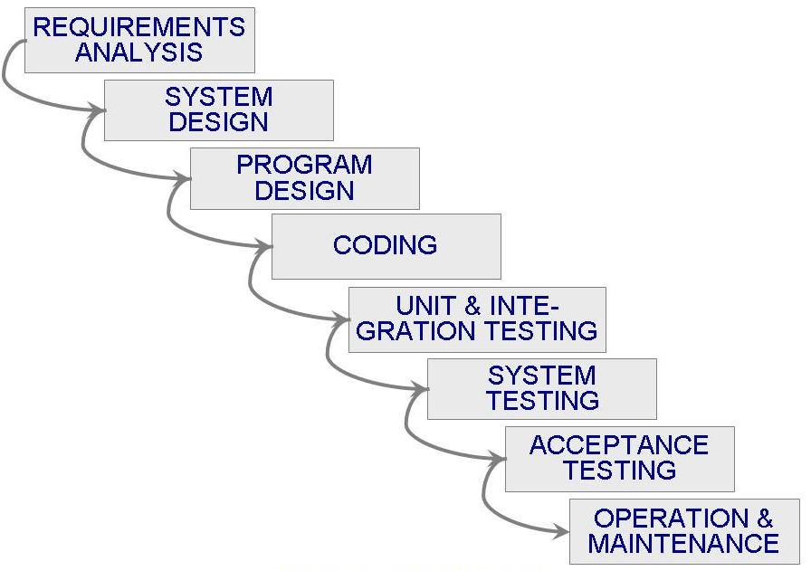
Waterfall Model

Slide 8

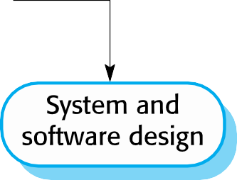
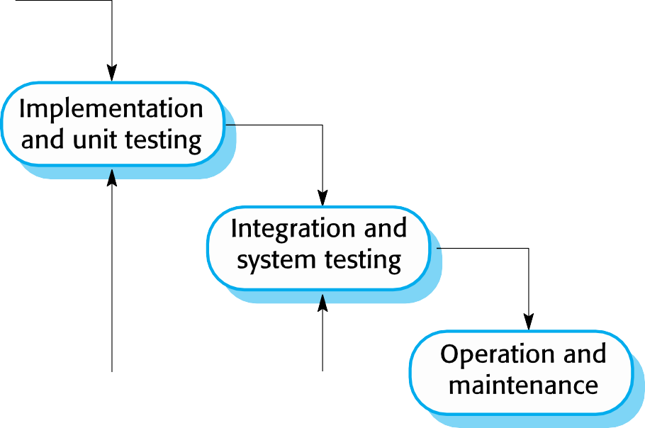
The waterfall model

Slide 9
Waterfall model phases
There are separate identified phases in the waterfall
model:
Requirements analysis and definition
System and software design
Implementation and unit testing
Integration and system testing
Operation and maintenance
The main drawback of the waterfall model is the difficulty of accommodating change after the process is underway. In principle, a phase has to be complete before moving onto the next phase.

Slide 10
Waterfall model problems
Inflexible partitioning of the project into distinct stages makes it difficult to respond to changing customer requirements.
Therefore, this model is only appropriate when the requirements are well-understood and changes will be fairly limited during the design process.
Few business systems have stable requirements.
The waterfall model is mostly used for large systems engineering projects where a system is developed at several sites.
In those circumstances, the plan-driven nature of the waterfall
model helps coordinate the work.

Slide 11
Process activities

Slide 12
Process activities
Real software processes are inter-leaved sequences of technical, collaborative and managerial activities with the overall goal of specifying, designing, implementing and testing a software system.
The four basic process activities of specification, development, validation and evolution are organized differently in different development processes.
For example, in the waterfall model, they are organized in sequence, whereas in incremental development they are interleaved.

Slide 13
Software specification
The process of establishing what services are required and the constraints on the system’s operation and development.
Requirements engineering process
Requirements elicitation and analysis
What do the system stakeholders require or expect from the system?
Requirements specification
Defining the requirements in detail
Requirements validation
Checking the validity of the requirements

Slide 14
Software design and implementation
The process of converting the system specification into
an executable system.
Software design
Design a software structure that realises the specification;
Implementation
Translate this structure into an executable program;
The activities of design and implementation are closely
related and may be inter-leaved.

Slide 15
System implementation
The software is implemented either by developing a program or programs or by configuring an application system.
Design and implementation are interleaved activities for
most types of software system.
Programming is an individual activity with no standard process.
Debugging is the activity of finding program faults and correcting these faults.

Slide 16
Software validation
Verification and validation (V & V) is intended to show that a system conforms to its specification and meets the requirements of the system customer.
Involves checking and review processes and system
testing.
System testing involves executing the system with test cases that are derived from the specification of the real data to be processed by the system.
Testing is the most commonly used V & V activity.

Slide 17
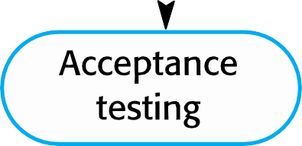

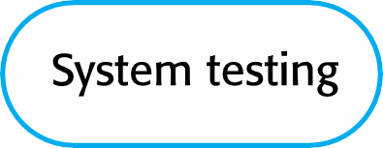
Stages of testing

Slide 18
Testing stages
Component testing
Individual components are tested independently;
Components may be functions or objects or coherent groupings of these entities.
System testing
Testing of the system as a whole. Testing of emergent properties is particularly important.
Customer testing
Testing with customer data to check that the system meets the customer’s needs.

Slide 19
Software evolution
Software is inherently flexible and can change.
As requirements change through changing business circumstances, the software that supports the business must also evolve and change.
Although there has been a demarcation between development and evolution (maintenance) this is increasingly irrelevant as fewer and fewer systems are completely new.

Slide 20
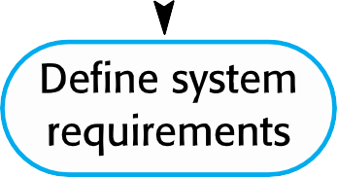
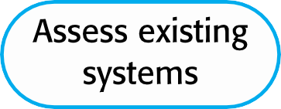
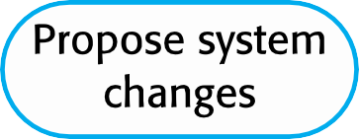
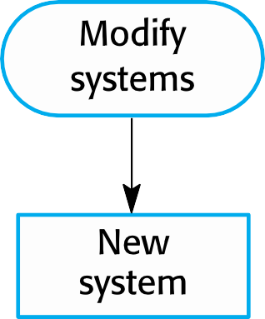
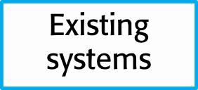
System evolution

Slide 21
Definitions
Iterate
to utter or do repeatedly
iteration n. – iterative adj
Increment n
1. amount of increase
2. a becoming greater or larger; increase
incremental adj

Slide 22
Incremental Development
Building and releasing one feature at a time depending on priorities defined by the customer
You have all the requirements
you design the complete product first. You only leave out details that you can safely decide later.
Then you slice it up into chunks and build each separately.
When you finish a chunk, aka module, you integrate it with previously completed parts, so they work as a whole.

Slide 23
Example: Ecommerce website
Consider a team building an ecommerce website using incremental development. The final target product has search, product information, a shopping basket, checkout, favourites, and customer reviews.
For the first released increment, the team builds the basic functionality to buy a product. It includes search, product information, adding products to a shopping basket and checkout. This first slice would only be released once it’s complete.
The second released increment builds on that basic functionality, and would add another capability such as favourites. The would be released when the favourites functionality is complete.
The third released increment adds customer reviews once that is complete, and so on.

Slide 24
Iterative Development
Iterative development is a lot like inventing: discovering what and how you need as you go.
Build the overall solution/product and then refine some of the areas that require improvement
You start with a fair idea of what you want the product to accomplish, and you use a process of successive approximation to design and build it.
You begin by designing, building, and testing the tiniest version of what you have in mind. When you’re happy, you show it and collect feedback from everybody with a stake in the product.
If what you created was well received, you keep it and expand on it in the next iteration. If what you created got the thumbs down, you discard it and go back to the drawing board

Slide 25
Example: Ecommerce website
Assume a team building the same ecommerce website using an iterative process.
The first release has a really stripped back version of all the required functionality; namely search, product information, a shopping basket, checkout, favourites, and customer reviews.
For the second iterative release, the team would improve some of the existing basic functionality, taking into account feedback from stakeholders or customer, or other inputs such as analytics.
On every subsequent iterative release, new ideas and requirements are added or low value/usage areas may be removed.

Slide 26
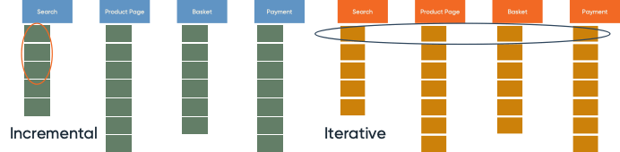
Example: Ecommerce website

Slide 27
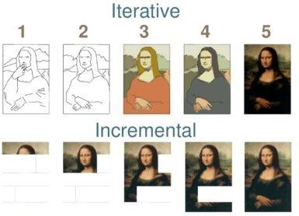
Example: Artist painting a picture

Slide 28
Coping with change

Slide 29
Coping with change
Change is inevitable in all large software projects.
Business changes lead to new and changed system requirements
New technologies open up new possibilities for improving
implementations
Changing platforms require application changes
Change leads to rework so the costs of change include both rework (e.g. re-analysing requirements) as well as the costs of implementing new functionality

Slide 30
Coping with changing requirements
System prototyping, where a version of the system or part of the system is developed quickly to check the customer’s requirements and the feasibility of design decisions. This approach supports change anticipation.
Incremental delivery, where system increments are delivered to the customer for comment and experimentation. This supports both change avoidance and change tolerance.

Slide 31
Software prototyping
A prototype is an initial version of a system used to
demonstrate concepts and try out design options.
A prototype can be used in:
The requirements engineering process to help with requirements
elicitation and validation;
In design processes to explore options and develop a UI design;
In the testing process to run back-to-back tests.

Slide 32
Benefits of prototyping
Improved system usability.
A closer match to users’ real needs.
Improved design quality.
Improved maintainability.
Reduced development effort.

Slide 33
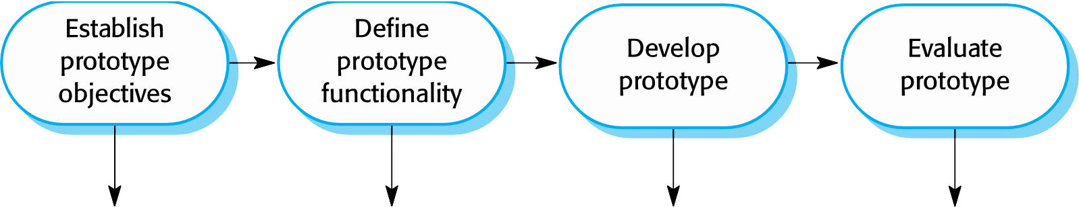
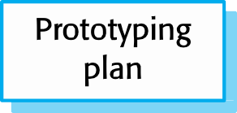
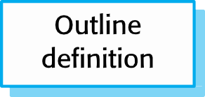
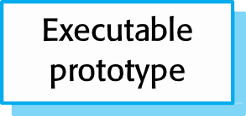
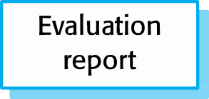
The process of prototype development

Slide 34
Prototype development
May be based on rapid prototyping languages or tools
May involve leaving out functionality
Prototype should focus on areas of the product that are not well- understood;
Error checking and recovery may not be included in the prototype;
Focus on functional rather than non-functional requirements such as reliability and security

Slide 35
Throw-away prototypes
Prototypes should be discarded after development as
they are not a good basis for a production system:
It may be impossible to tune the system to meet non-functional requirements;
Prototypes are normally undocumented;
The prototype structure is usually degraded through rapid change;
The prototype probably will not meet normal organisational quality standards.

